Slide 1
DMW Mini project

Slide 2
Stock market price prediction using lstm
Data set gathering (apple stock price dataset)
Data cleaning
Splitting of data in tain test sets
Model creation
Training of model
Testing of model

Slide 3
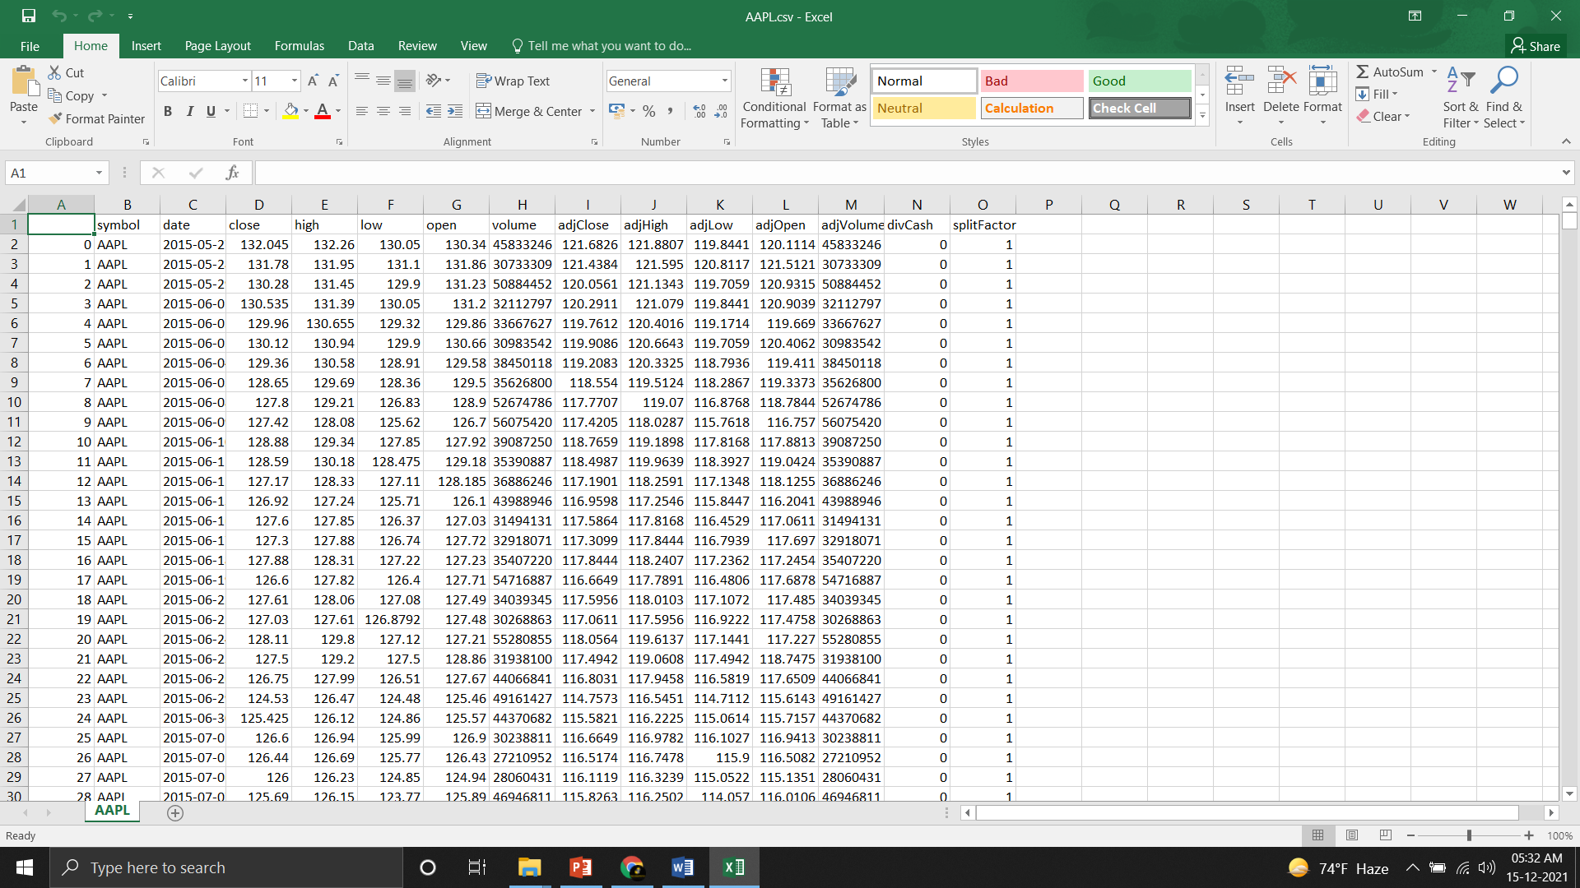
Data set gathering and cleaning

Slide 4
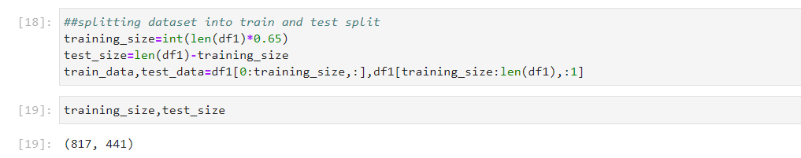
Splitting data in train test sets

Slide 5
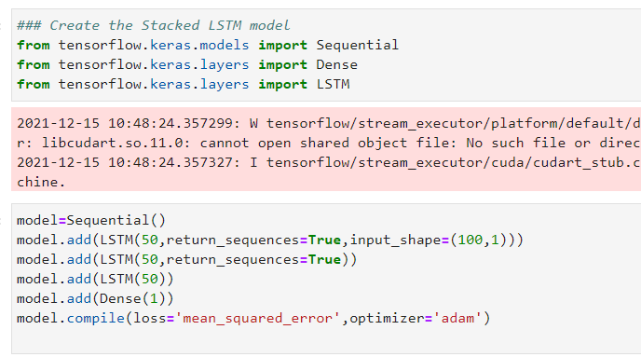
Model creation

Slide 6
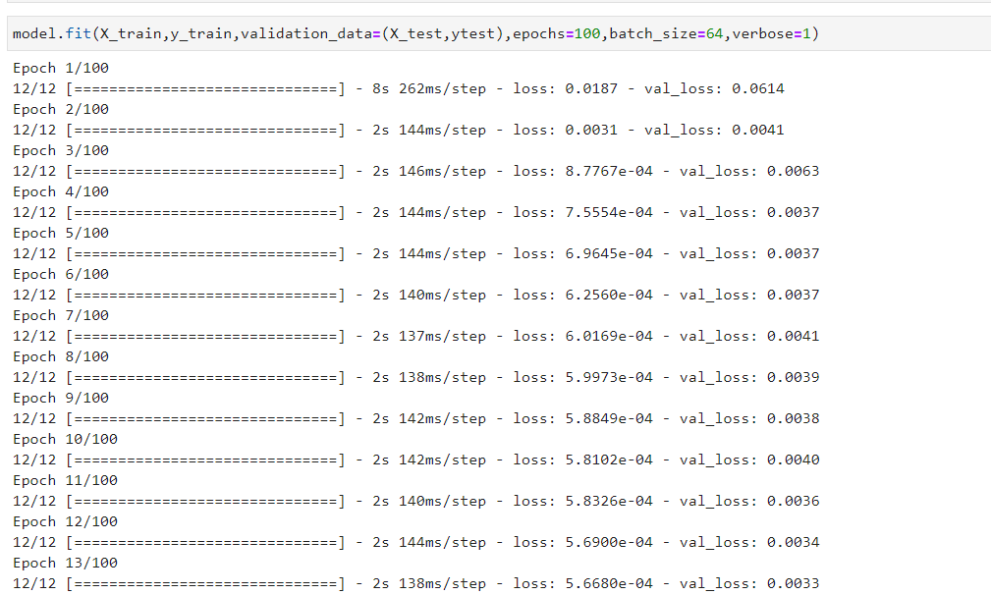
Training of model

Slide 7
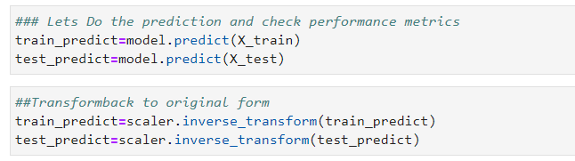
Testing the model

Slide 8
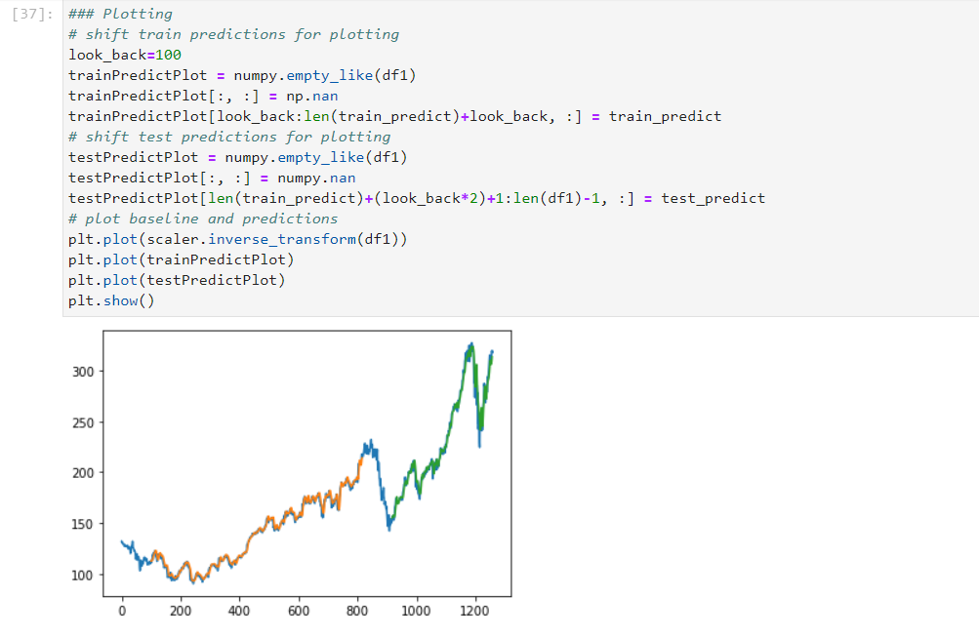
Plotting the predicted data

Slide 9
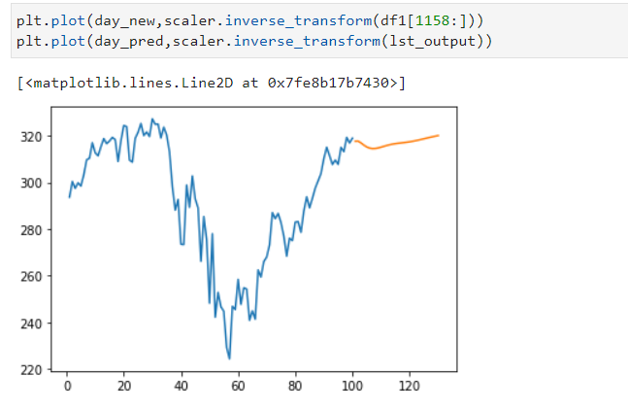
Predicted data

